Slide 1

Presenter: Lo Jingjie
CS3244 Group 31 Project
HDB Resale Flats
Price Predictions
This is a cover page which is not restricted to the 1min/2min requirement per slide

Slide 2





Presenter: Lo Jingjie
Motivation and Data
Once in a lifetime decision
Transactions made across multiple agent platforms
Help families make informed decisions when purchasing a flat by forecasting Resale Values
OneMap API for Location Extraction
General Schools Information
(data.gov.sg)
Resale HDB Flat Transactions
(data.gov.sg)
MRT Stations and Postal Code Dataset
(Kaggle)
HDB Property Information
(data.gov.sg)

Slide 3
Presenter: Lo Jingjie
Feature Engineering
Closest MRT Station
and its distance
Closest Elite Schools
Additional Property Information
Flats closer to MRT Stations have higher resale value prices
Make asynchronous API queries to OneMAP to retrieve longitude and latitude of all buildings
Used Python geopy library to compute pairwise distances
Obtain closest MRT station and its distance to flat
Flats close to elite schools have higher resale value
Computed pairwise distance between Flats and closest schools
Tagged closest school as elite if its a SAP school, Autonomous School, Gifted School or IP School.
Additional Features about the flat that could be meaningful
e.g. Year of Completion, Close to hawker center, close to multi-storey carpark, ...
Excluded live features like to-date 3room flats sold volume.
Easily joined with Transactions dataset

Slide 4

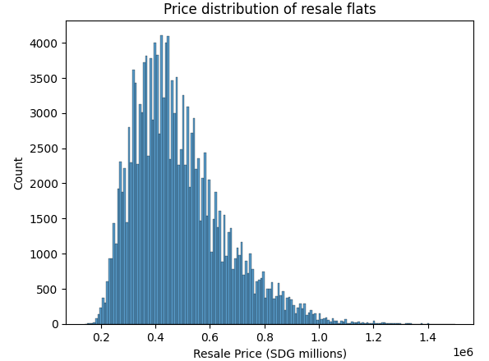
EDA
Presenter: Liew Cheng Yee

Slide 5
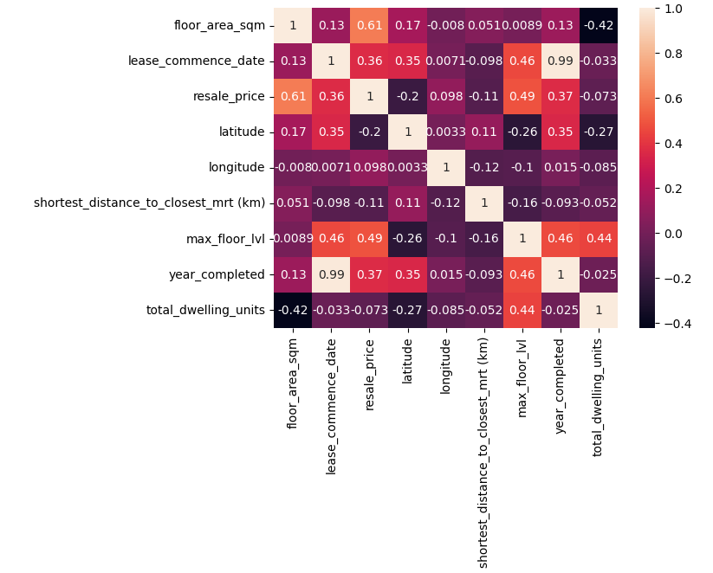
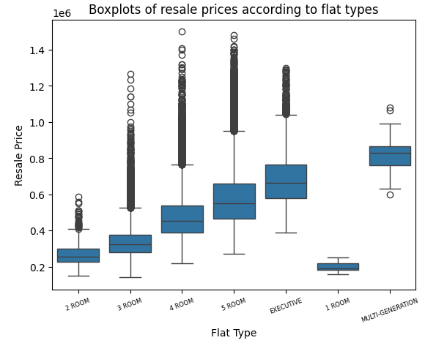
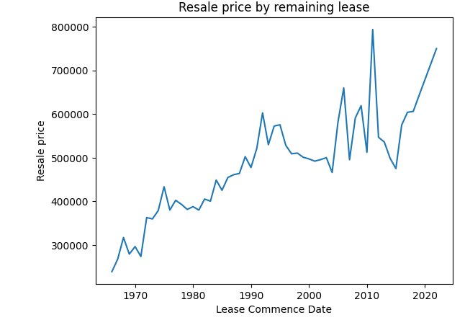
EDA
Presenter: Liew Cheng Yee

Slide 6
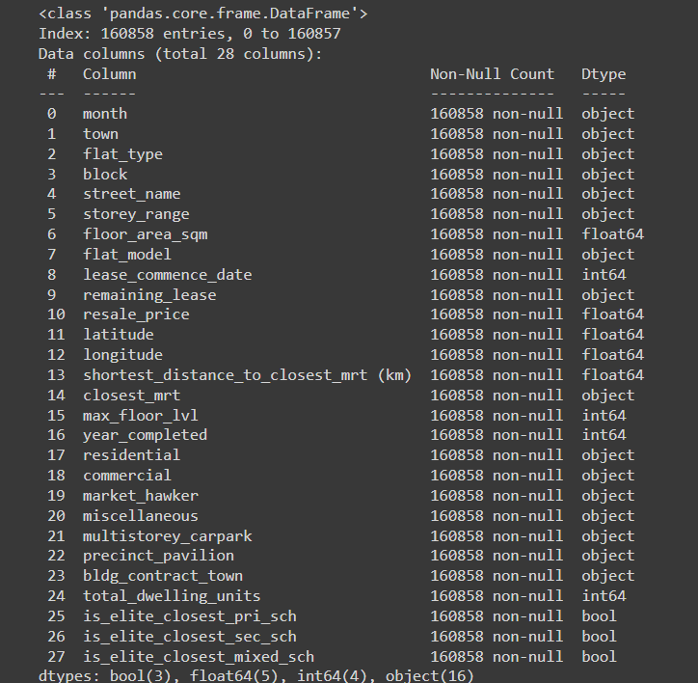
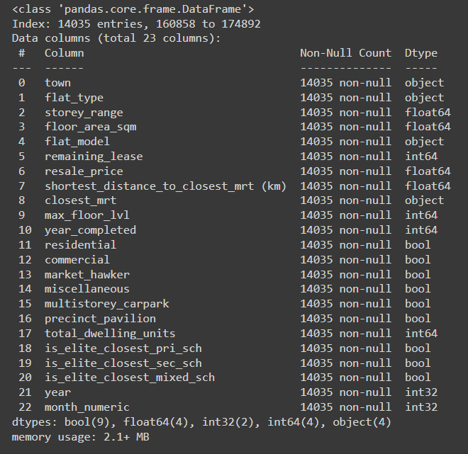
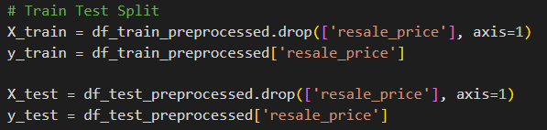
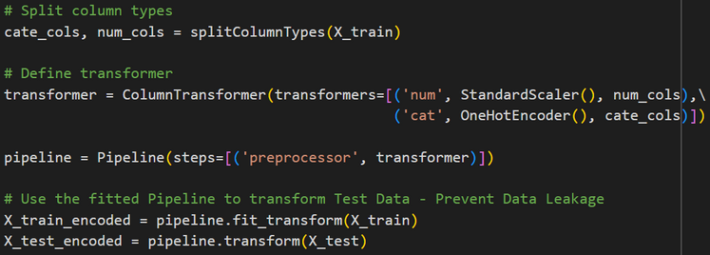
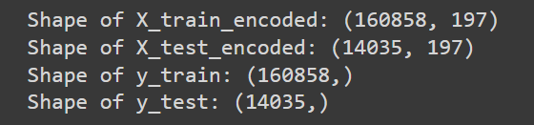
Presenter: Dao Trong Khanh
Data Preprocessing
Unprocessed Dataset
Processed Dataset
Train Test Split
Feature Encoding

Slide 7
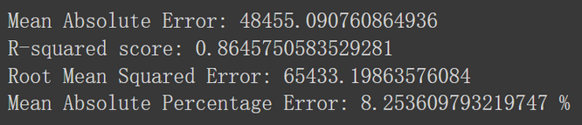
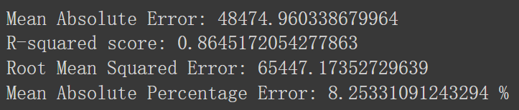
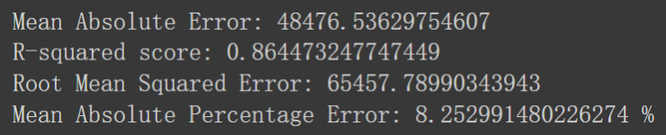
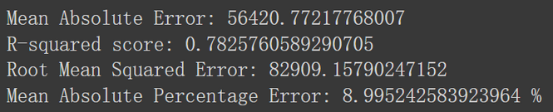
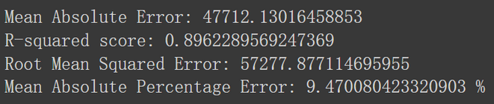
Presenter: Chen Ziju
Linear Regression
(Without Regularization)
Basic predictive model assuming direct proportionality between variables
L1 Regularization (Lasso)
Shrinks less impactful feature weights to zero, simplifying models and aiding interpretability
Adjusts linear regression, penalizing large coefficients to mitigate overfitting; enhances generalization
L2 Regularization (Ridge)
Elastic Net (L1 + L2)
Integrates Ridge and Lasso penalties to optimize model complexity and feature selection
Multi-Layer Perceptron
Flexible neural network, learning non-linear relationships through multiple processing layers

Slide 8






Presenter:Xu Wenxuan
Decision Tree Regressor
Random Forest Regressor
LightGBM
XGBoost
A leaf-wise tree-based boosting strategy
This approach helps in improving on the accuracy of the model performances
A level-wise tree-based boosting strategy
This approach ensures that the trees are balanced and often helps in reducing overfitting
December, 2022

Slide 9

Feature Importance
Presenter:Xu Wenxuan
LGBM and Random Forest
XGBoost
floor_area_sqm
max_floor_lvl
storey_range
year
remaining_lease
flat type
town

Slide 10
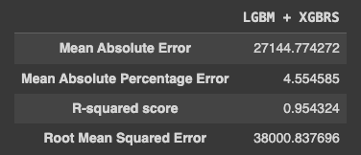


Hybrid Model
Presenter:Xu Wenxuan
LightGBM
XGBoost

